Slide 1
1st Romanian Presidency of the Permanent Committee on Cadastre in the European Union Vienna, 22nd November, 2018
Radu Codrut Stefanescu,
President - Director General, ANCPI
Notes:
At first I would like to thank President Hoffman and his staff for the outstanding event that we have all been part of. We will do the same to follow your good example.
For the first time from its inclusion in the European Union, in 2007, Romania will hold the Presidency of the Council and we, ANCPI of Romania, will follow BEV to the Presidency of PCC. We promise to do our best to continue the good work started today!

Slide 2
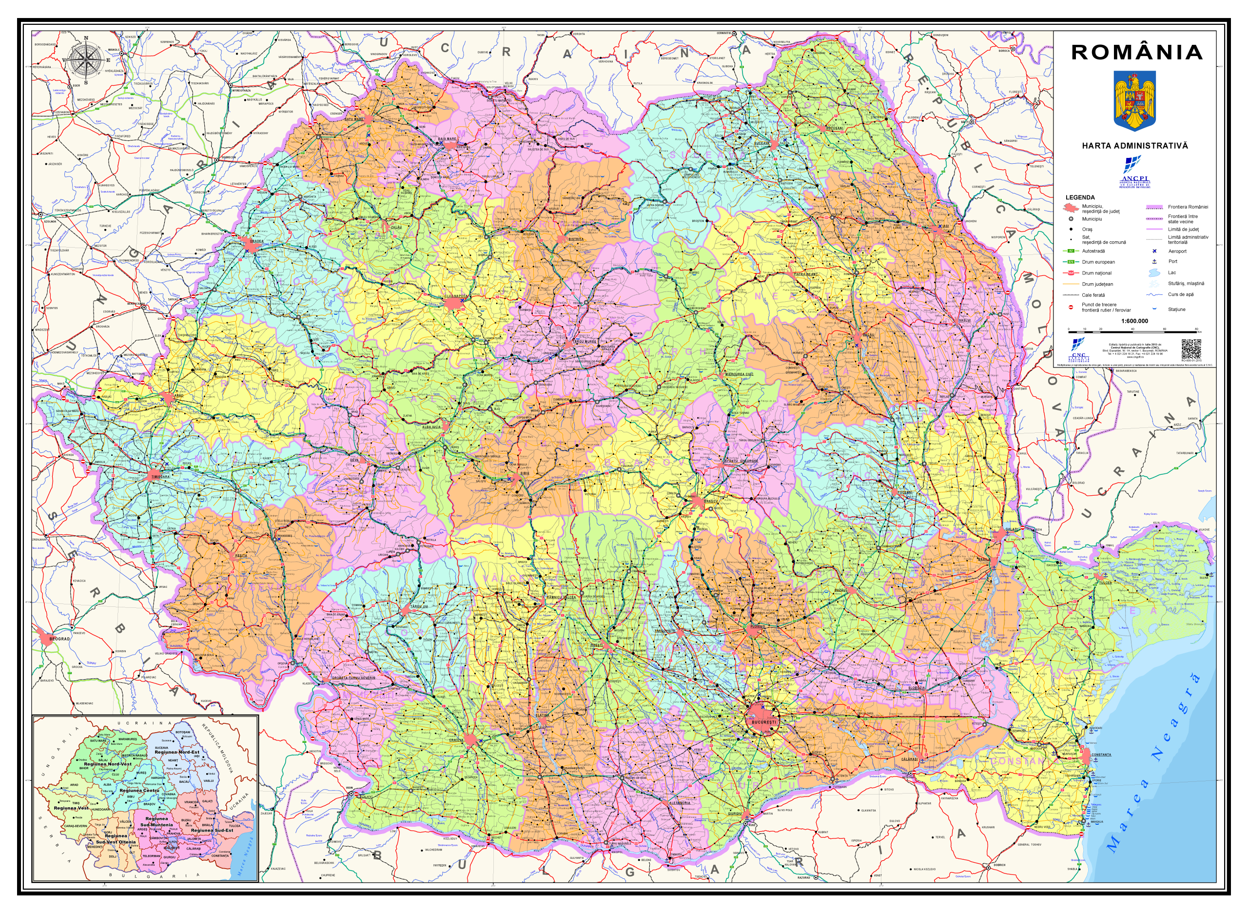
Romania
Notes:
Dear Colleagues, I am sure that this image is familiar to all of you. The map of Romania. I would like to tell you a bit more about my country, like, for example, that Austria and Romania are splendidly connected by the River Danube…

Slide 3
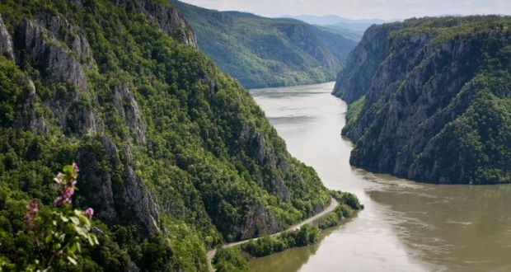
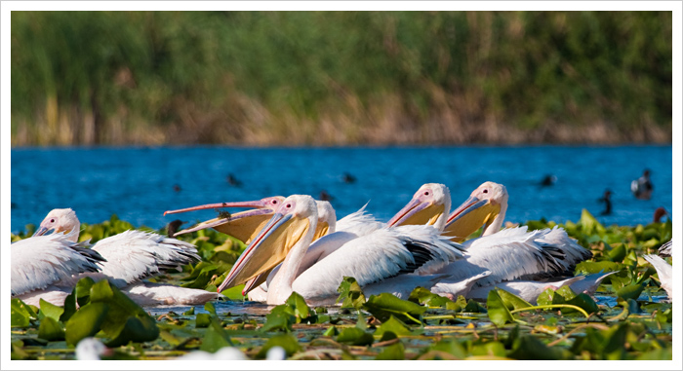
The Danube and its Delta
Notes:
That springs from the Austrian mountains and ends its grandious course in the Danube Delta… a treasure of unspoiled nature, biodiversity…

Slide 4
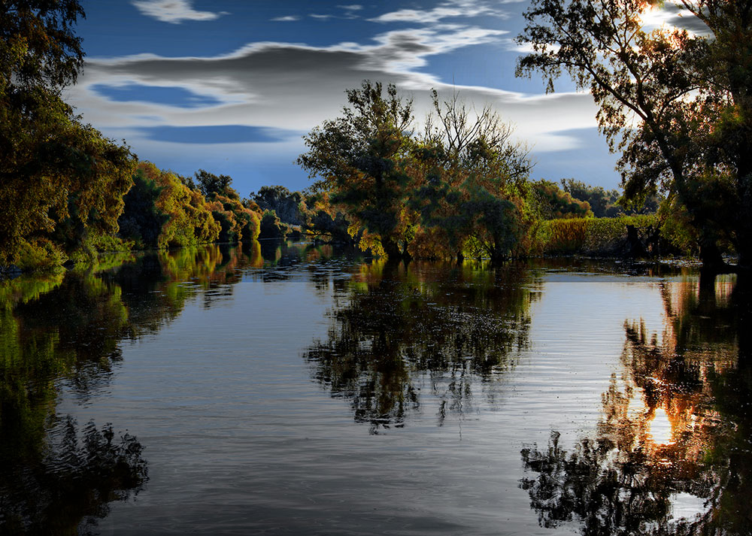
…the unspoiled nature
Notes:
…and serenity that are calling every year thousands and thousands of visitors.

Slide 5
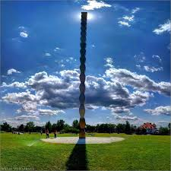
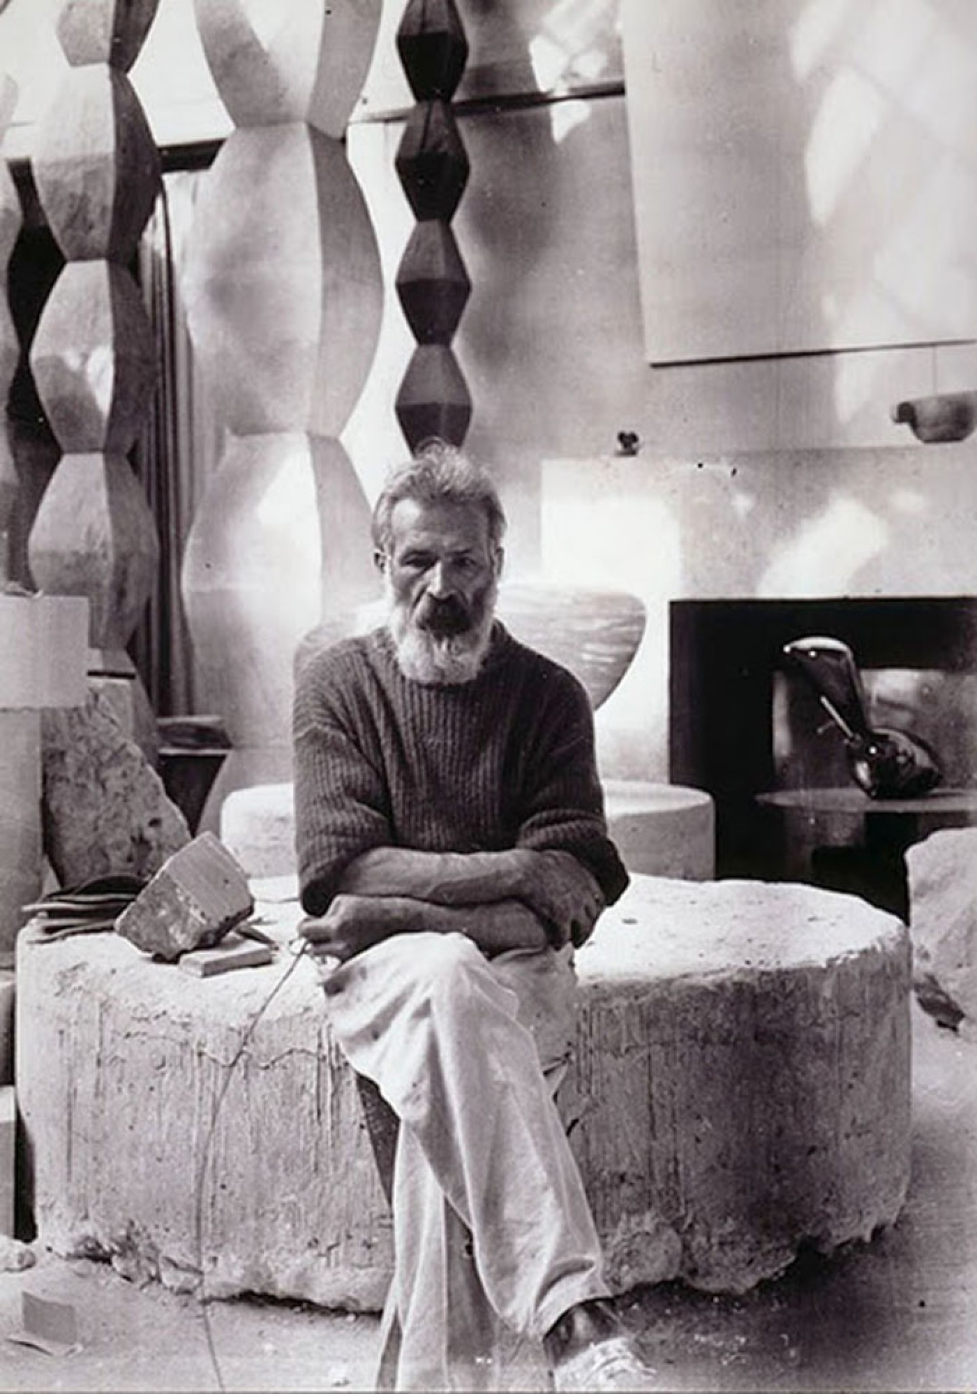
…Constantin Brancusi…
Notes:
We are proud by our ancestors, mainly when they brought added value to the European culture. Let me recall here Constantin Brancusi, whose geniality created amazing art operas.

Slide 6
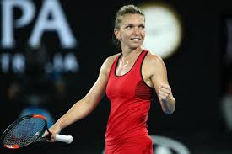
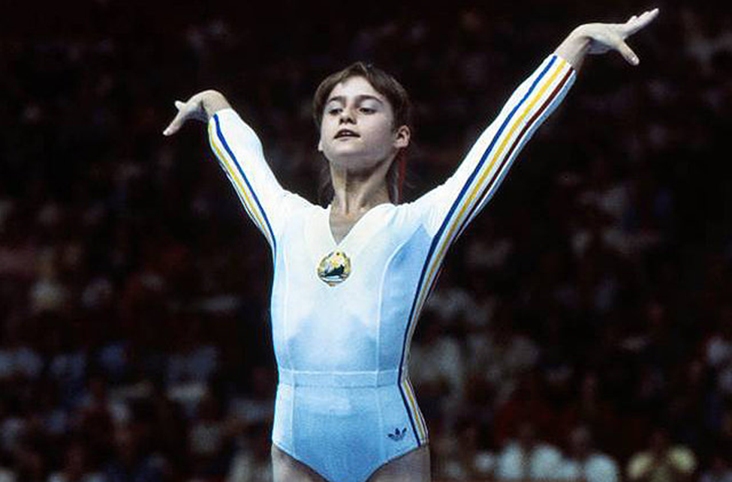
...Sports…
Notes:
Champions are representative for every nation, and motivate younger generations to work harder and become better. Here are some very wellknown Romanian Champs: Nadia COMANECI, who conquered our hearts and the first “10” at the Olympic Games in Montreal, Gica HAGI – the Romanian football player and Simona HALEP – an example of tenacity and hard working!

Slide 7
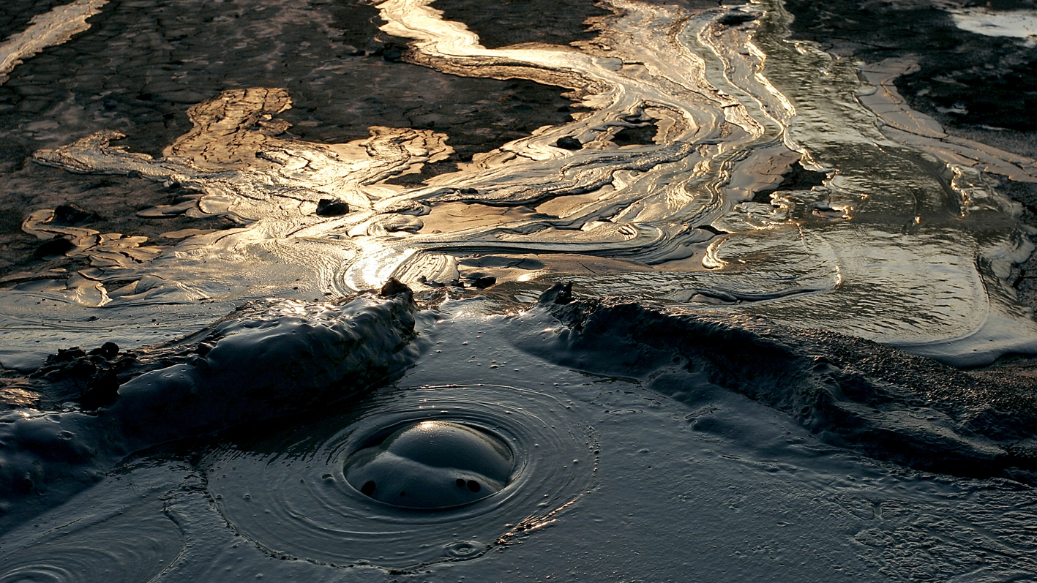
Spectacular or Legendary Places like…
Notes:
I also believe that the Muddy Volcanos are something unique in Europe…

Slide 8
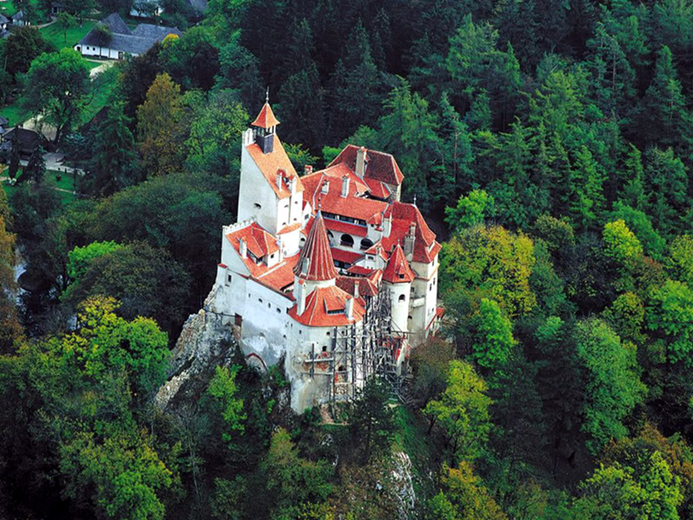
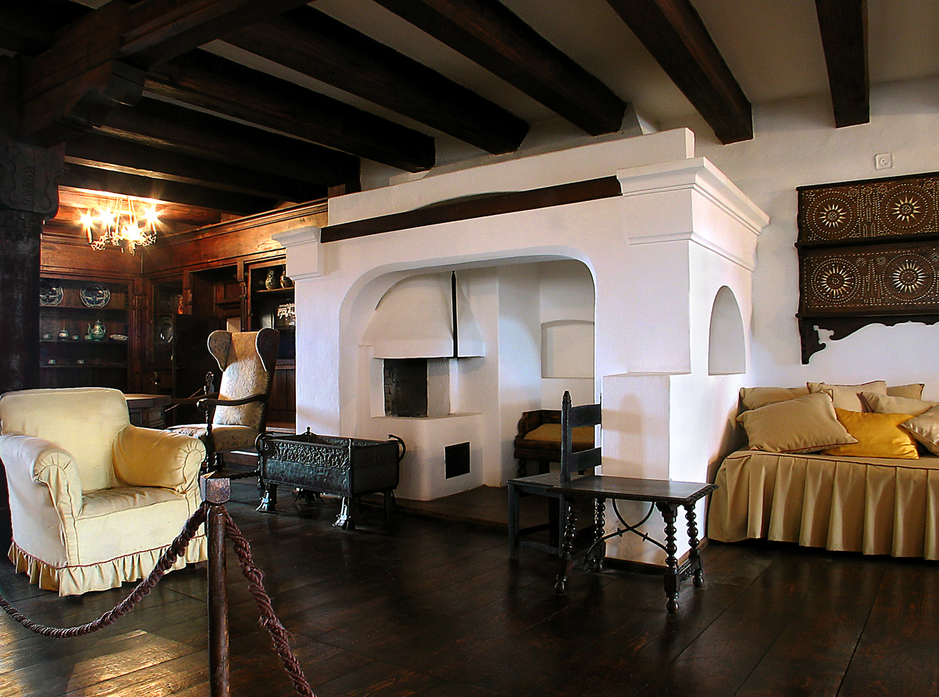
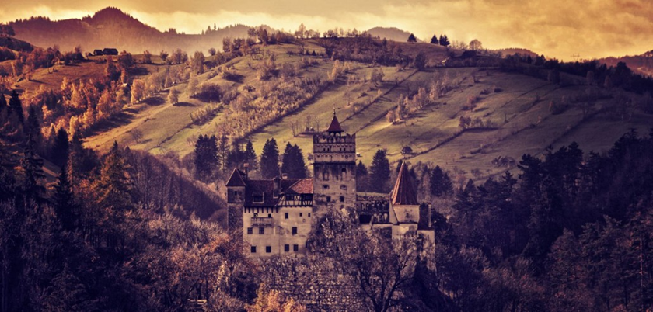
Notes:
And who did not hear about the legendary Bran Castle where Vlad the Impaller lived and became famous grace to Bram Stoker and his “Dracula”.
Please, dear ladies and Gentlemen, take this like an invitation to visit Romania and discover all these and more…by yourselves!

Slide 9
Romanian Presidency of the Council of the European Union „COHESION, A COMMON EUROPEAN VALUE“ a call to unity and coherence, with a view to adopting action lines to ensure a strong, responsive European Union that is close to its citizens
Notes:
As of January 1st, 2019, Romania will be handed over the Presidency of the Council. The motto under the Romanian Presidency is “COHESION, a COMMON EUROPEAN VALUE” – stating clearly the intention of Romania to support the European policies addressed equally to all the countries and their citizens, and to safeguard the common European values

Slide 10
Romanian Presidency of the PCC Main objectives/priorities
To continue the discussions on the role of PCC and its organisational structure;
To support the collaboration with the relevant European groups in the field of cadastre and enhance the visibility of PCC;
To organise the PCC Conference and PCC Plenary Meeting;
To represent PCC at the conferences and meetings.
Notes:
We, ANCPI, shall work together with the former and coming PCC Presidencies in order to define a more concrete role of the PCC, and to formalize it in a way that allows a better visibility.

Slide 11
Romanian Presidency of the PCC Conference and Plenary Meeting The Economic Impact of Cadastre for the Society 6th – 7th June, 2019 Bucharest
Notes:
Cadastral information is for sure at the basis of each and every investment. Drawing policies at national or regional levels, monitoring crops or subsidies for agriculture, following migration of protected species, deciding where to place a school or a kidergarden, all these facts use cadastral information.
We can say that the economic progress, transparency and investments are all benefitting from the cadastre information that we are producing.
Let’s debate together on this topic, next year in June!

Slide 12
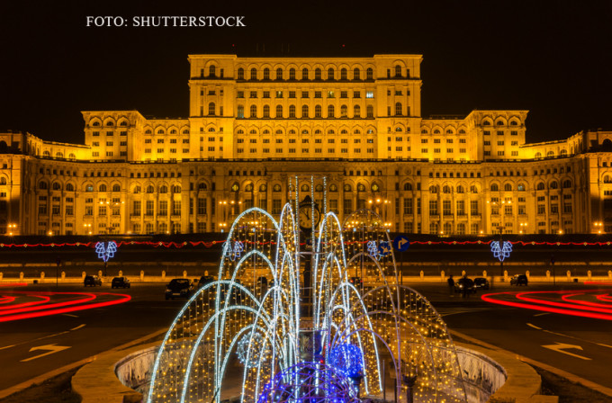
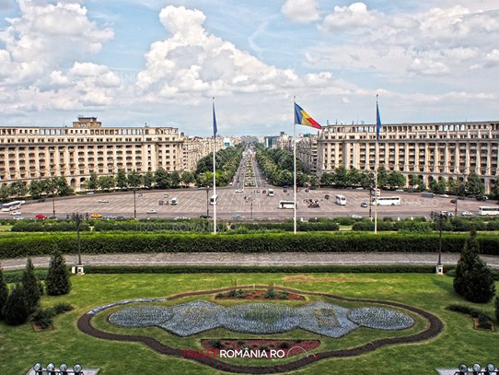
Hosted by the largest civil administrative building in the world Palace of Parliament - Bucharest
Notes:
We will all enjoy an outstanding location: the Palace of Parliament, the largest civil administrative building in the world, which has been erected using only Romanian materials. The wood, marble, crystal used inside are Romanian, and were designed and carved by Romanian artists.

Slide 13
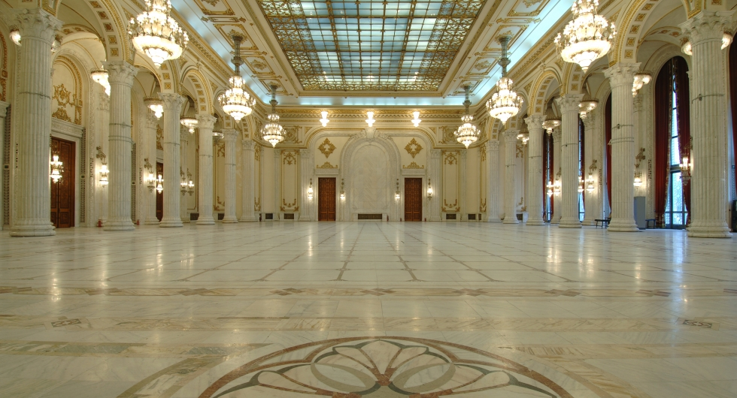
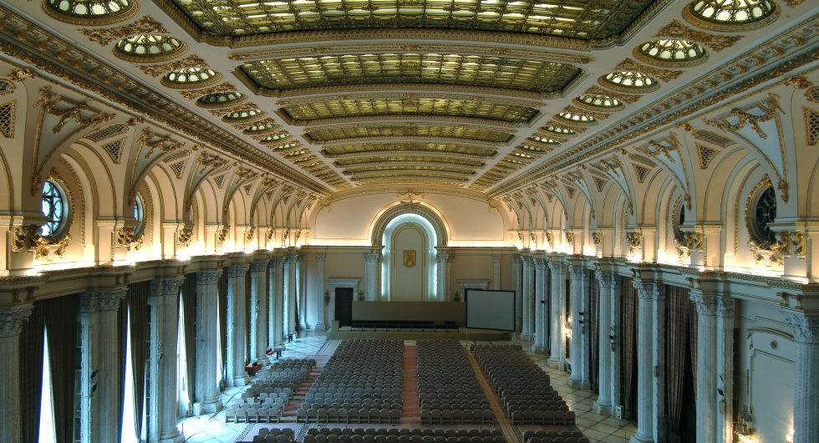
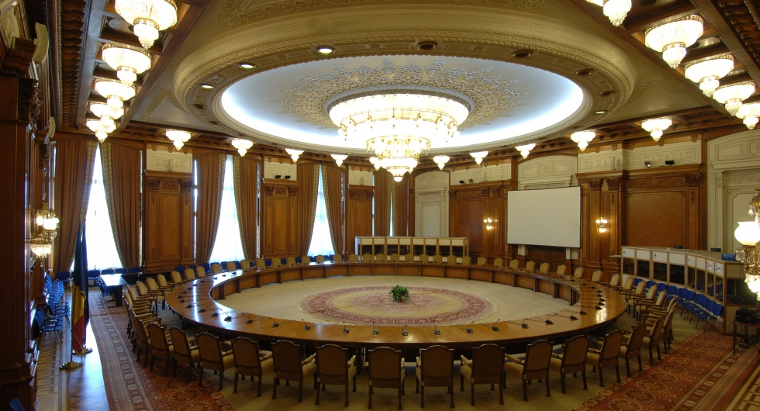
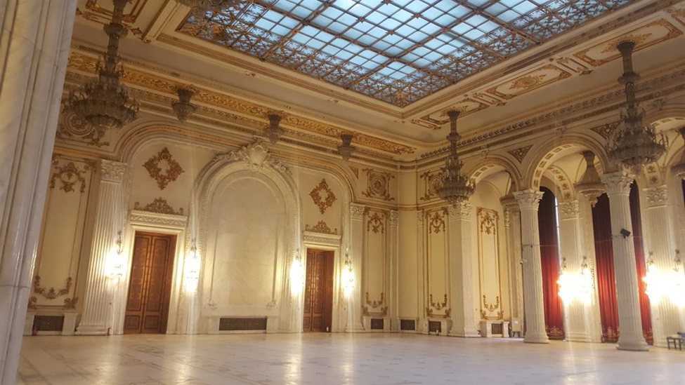
Palace of Parliament - Bucharest
Notes:
Here are some of the interiors of the Palace of Parliament…

Slide 14
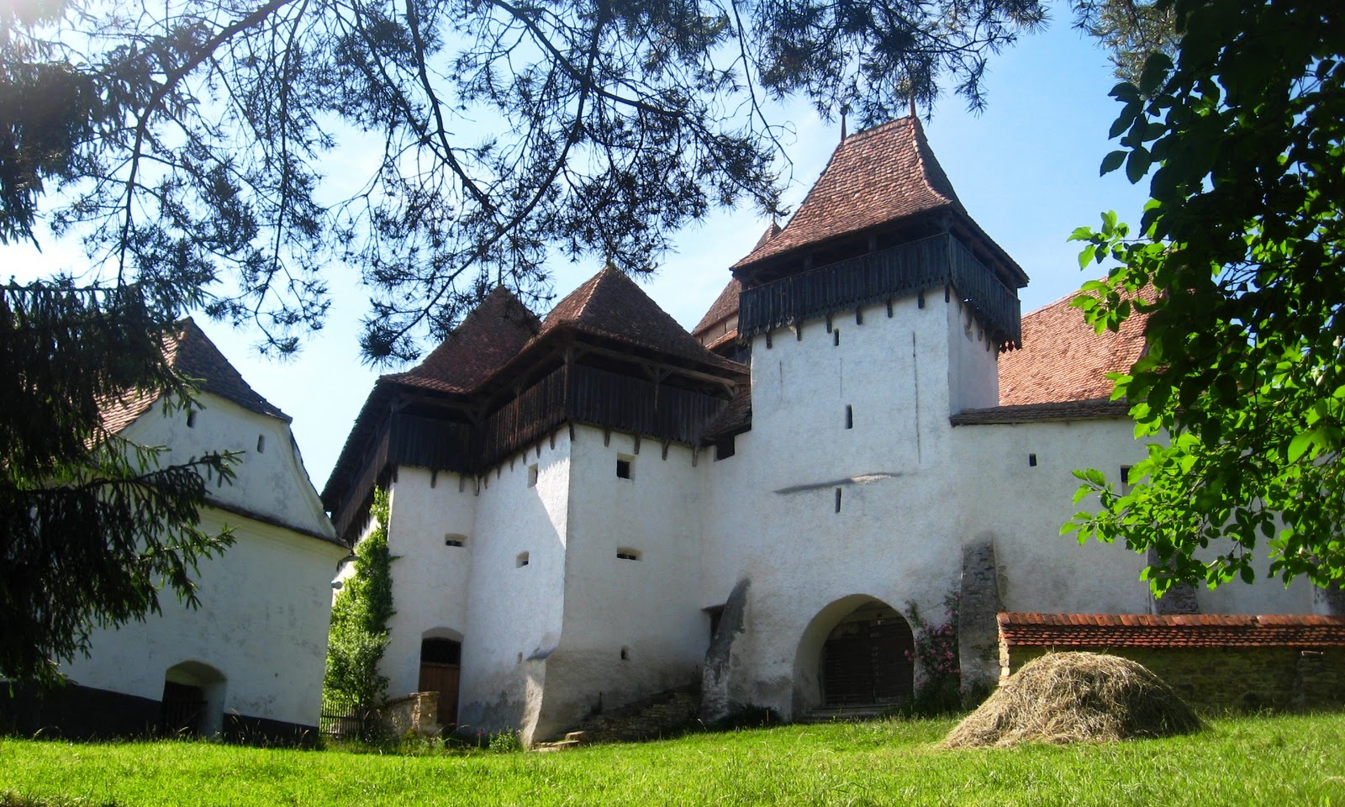
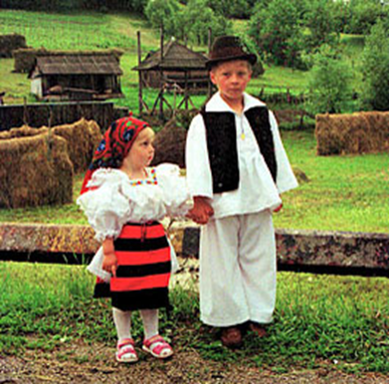
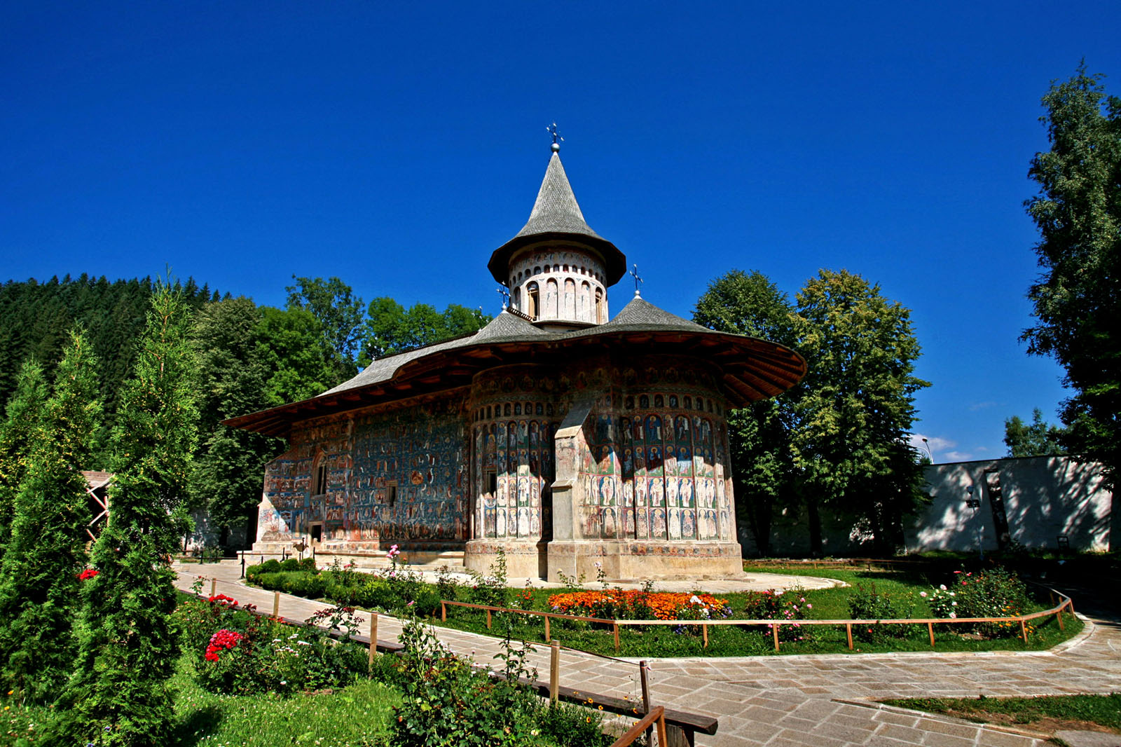
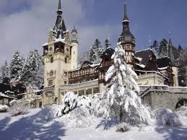
Notes:
And here, some of the places that made Romania well known: The Citadel of Viscri, the Voronet monastery - famous for the special shade of blue of its paintings, or the Peles Castle

Slide 15
Save the Date! Looking forward to welcoming you in Bucharest!
Notes:
We are happy to invite you to Bucharest next June, to participate in the lifely debates occasioned by the conference,
But also to make new friends, to discover Romanian traditions, gastronomy & vines, the beauties of Bucharest and why not?… to come again! THANK YOU!

